Slide 1
第二十章 车架与承载式车身
Chapter20:Frame and Uni Body

Slide 2
主要内容
Main Contents
车架的功用、结构要求、分类：
Function of frame、Requirements of its structure、Classification；
边梁式车架的结构特点；
Structural characteristics of fringe-beam frame；
中梁式车架的结构特点；
Structural characteristics of backbone type frame；
综合式车架的结构特点；
Structural characteristics of Integrated type frame
承载式车身的结构特点。
Structural characteristics of Uni Body.

Slide 3
车架的功用、结构要求以及分类
Function of frame、Requirements of its structure、Classification
车架的功能
Function of frame
支承和连接汽车的零部件，承受汽车的载荷。Support and connect the components and parts of an automobile, support the weight of the automobile.
车架的结构要求
Requirements of its structure
满足汽车总布置要求，能够安装全部零部件，并便于拆卸；Meet the need of general arrangement of the car，be able to equip all the components, be easy to dismantle；
具有足够的刚度和强度，避免因为车架变形引起的零部件运动干涉；Have sufficient rigidity and strength, avoid motion interference caused by deformation of frame；
满足轻量化要求；Meet the requirements of lightweight；
降低车辆的重心高度，提高车辆的操纵稳定性。Lower the center of gravity, improve the car’s handling stability.

Slide 4
车架的分类
Classification
按结构形式
Sorted by structure
边梁式车架；Fringe-beam frame;
中梁式车架（脊梁式车架）；backbone type frame ;
综合式车架；Integrated type frame;
承载式车身是用车身代替车架，以车身整体承受载荷的车身结构形式，广泛应用于轿车和客车。Uni Body is a kind of body structure that functions as frame. The whole body supports the weight. It’s widely applied to passenger car and coach/bus.

Slide 5
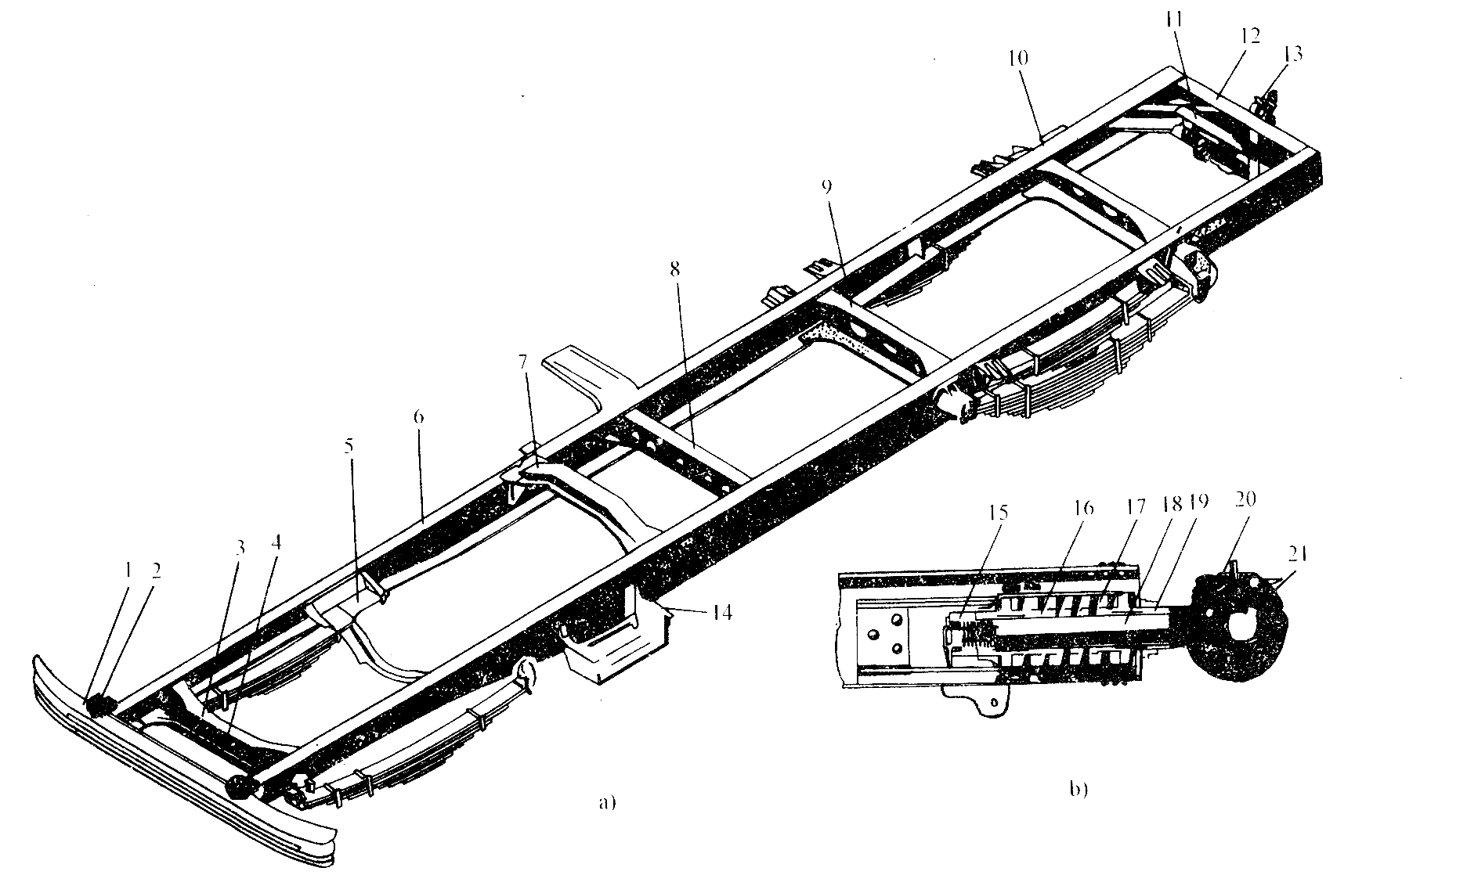
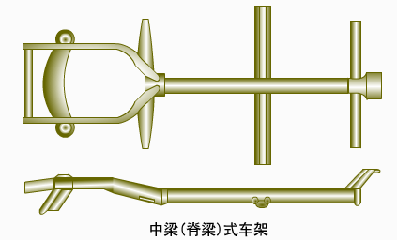
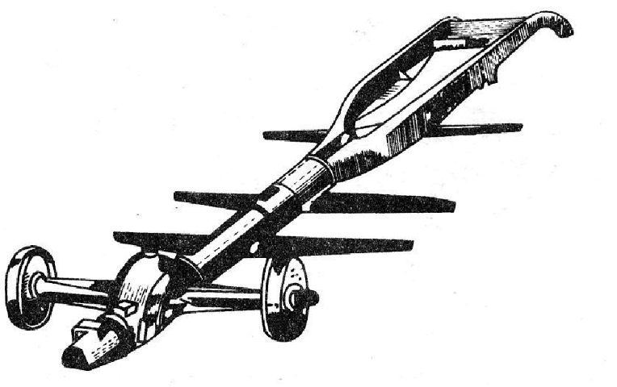
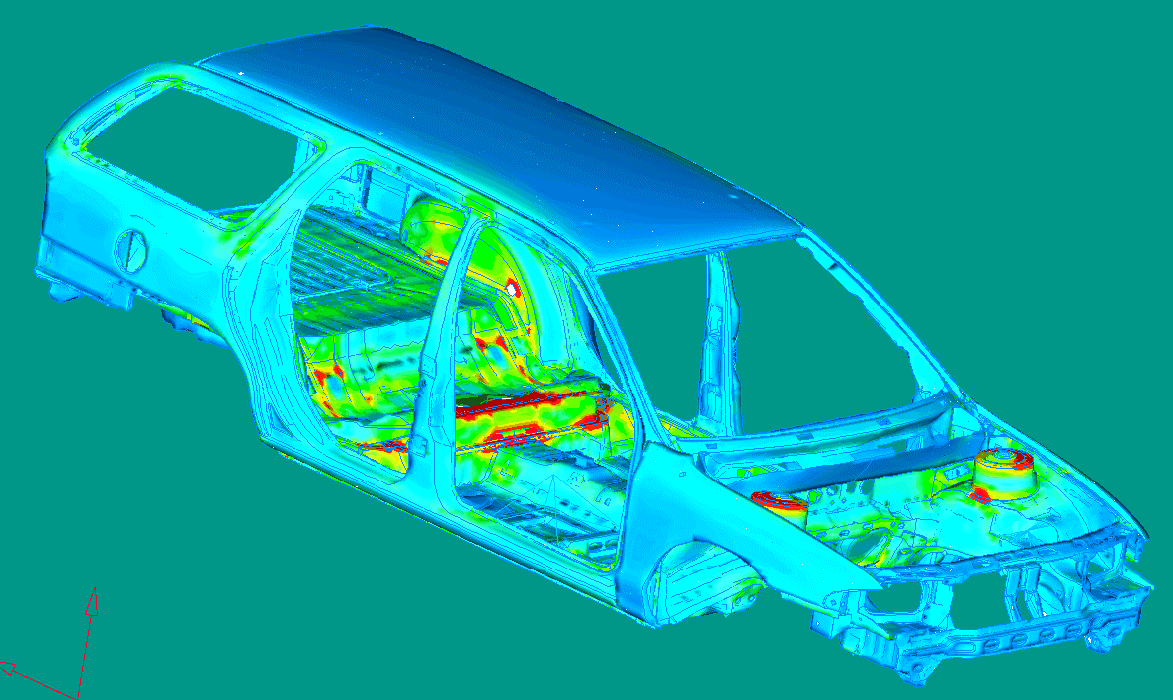
车架的分类Classification
边梁式车架Fringe-beam frame
中梁式车架Backbone type frame
综合式车架Integrated type frame
承载式车身Uni Body

Slide 6
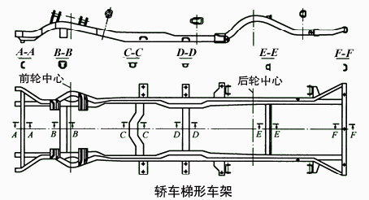
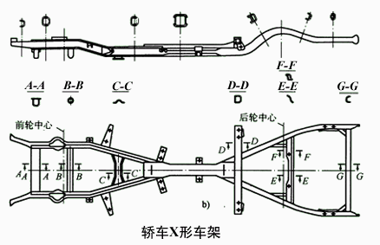
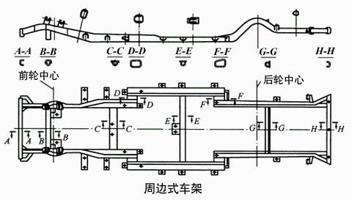
车架的分类Classification
车架从纵梁形状和结构特点又可分为周边式车架、X形车架以及梯形车架。The frame can be sorted as perimeter frame(周边式), x-shaped frame and Ladder type frame(梯形) according to the shape of its longeron and the structural characteristics

Slide 7
第一节 边梁式车架
Section 1: Fringe-Beam Frame
边梁式车架的组成：两根纵梁和若干个横梁通过焊接和铆接而成。Components of fringe-beam frame: two longerons and several crossbeams welded or riveted together.
纵梁longeron
横梁crossbeam

Slide 8
纵梁Longeron
纵梁用低碳合金钢冲压而成；Longeron is stamped by low-carbon alloy steel;
一般采用中间高、两端低不等高断面形式，以保证应力分布均匀。Mid part of its cross section is thick and both ends are thin, so that the stress is even.

Slide 9
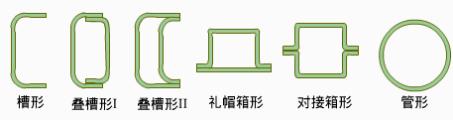
纵梁Longeron
纵梁的断面形状有开口形（槽形、Z形）、封闭形（箱形）等。The shape of cross section of longeron can be open (such as Z shape or groove shape) or close (such as box shape)

Slide 10
横梁Crossbeam
横梁一般也用低合金钢冲压而成，为增强车架的抗扭强度，纵梁的断面形状有管形和箱形；Crossbeam is also stamped by low-carbon alloy steel . In order to enhance the torsional strength of frame, The shape of cross section of crossbeam can be box shape or tube shape;
一般有前横梁、发动机安装梁、驾驶室安装梁、悬架安装梁、后横梁等。Generally a frame has a front crossbeam, engine mounting beam, cab mounting beam, suspension mounting beam, rear crossbeam and so on.
悬架安装梁
Suspension mounting beam
发动机安装梁
Engine mounting beam
第四横梁
Forth cross beam
前横梁
Front crossbeam
后横梁
Rear crossbeam
驾驶室安装梁
Cab mounting beam

Slide 11
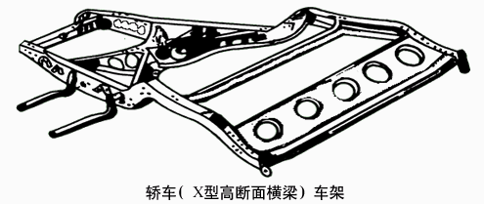
X形高断面横梁
X-shaped high cross-section beam
采用X型高断面的横梁，可以提高车架的扭转刚度，对于短而宽的车架，效果尤为显著，一般只用于轿车车架。By adopting X-shaped High cross-section beam can enhance the torsional strength of frame. And this is significantly effective for short and wide frame. Generally it’s only applied to frames of sedans.

Slide 12
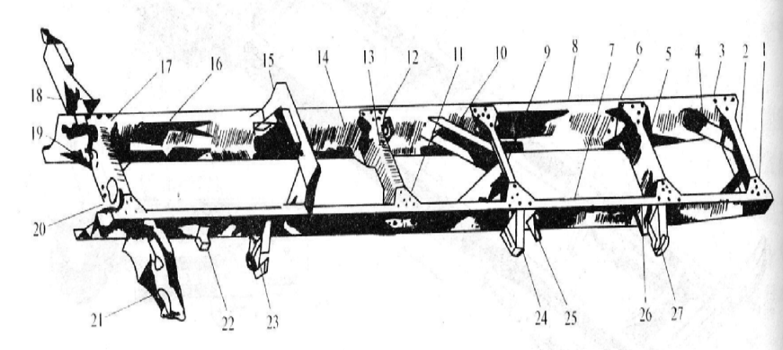
加强措施
Strengthening measures
为了增加车架的刚度，在横梁和纵梁连接时经常采用斜支撑、角支撑、和连接板等加强措施。In order to strengthen the stiffness of frame, inclined support, corner support, connecting plate and other strengthening measures are often adopted when connecting longerons and crossbeams.
加强措施Strengthening measures

Slide 13
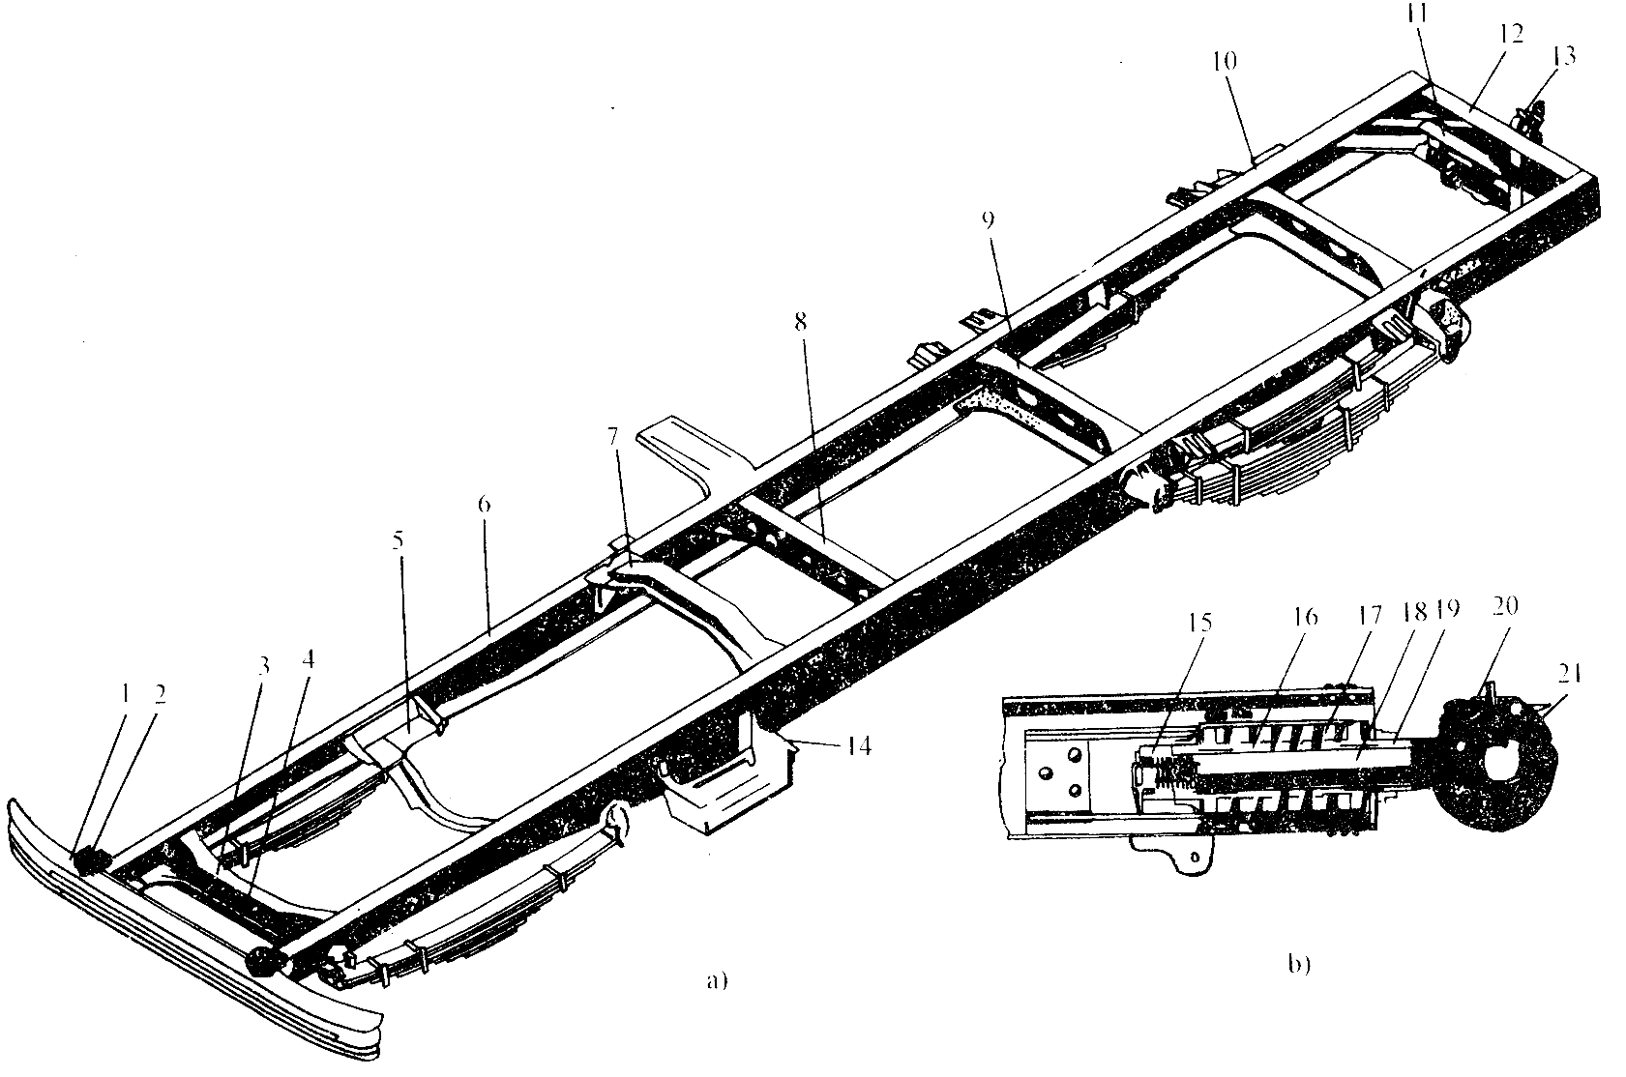
其它部件Other components
保险杠 ：一般安装在汽车的前、后横梁上，起到保护车身、散热器的作用。Bumper ：It is normally assembled on the front and rear beam and protects the body and the radiator.
挂钩：一般安装在汽车前部，用来在必要时拖动汽车。Drawbar： It is normally assembled on the front of the car and is used to pull the car when necessary.
拖钩：在可拖挂车的车辆的尾横梁上安装拖钩。Towing hook：It is assembled on the rear beam of a car that can be towed.
挂钩Drawbar
保险杠Bumper
拖钩Towing hook

Slide 14
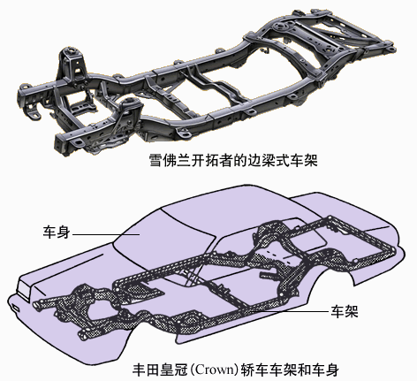
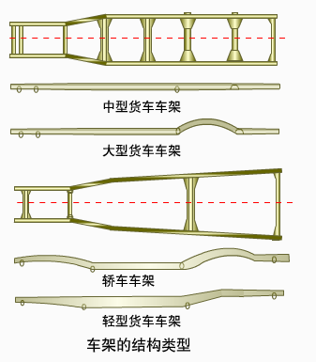
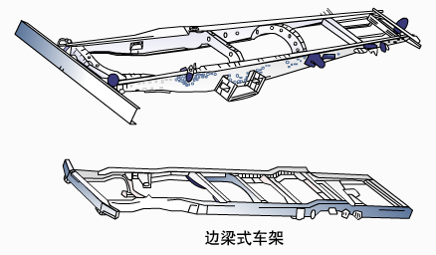
边梁式车架的结构形式
Structure form of fringe-beam frame
边梁式车架的结构形式因车型而异。The structure form of fringe-beam frame differ from one vehicle type to another

Slide 15
边梁式车架的特点
Features of fringe-beam frame
优点Advantages
结构简单、容易制造；Simple construction, be easy to manufacture;
有利于改装变型车或者多品种车辆；Be easy to modify to recreational vehicle or multipurpose vehicle;
便于布置和安装； Be easy to arrange and install;
具有较高的强度和刚度；Have enough stiffness and strength;
车架与驾驶室分开，采用弹性悬置安装，有利于隔振。Separated frame and passenger cab, mounted through spring and it benefits vibration isolation
缺点Disadvantages
重量较大；Heavy weight;
车身不参加承载，对扭转刚度无贡献；The body does not bear the weight and has no contribution to torsional stiffness;
正面碰撞事故中，车身易相对车架向前运动，加剧碰撞程度；When frontal crash accident happens, the body tend to move forward in comparison to the frame and aggravate the collision；
不利于降低底板高度。It does not benefit the lower of height of floor.

Slide 16
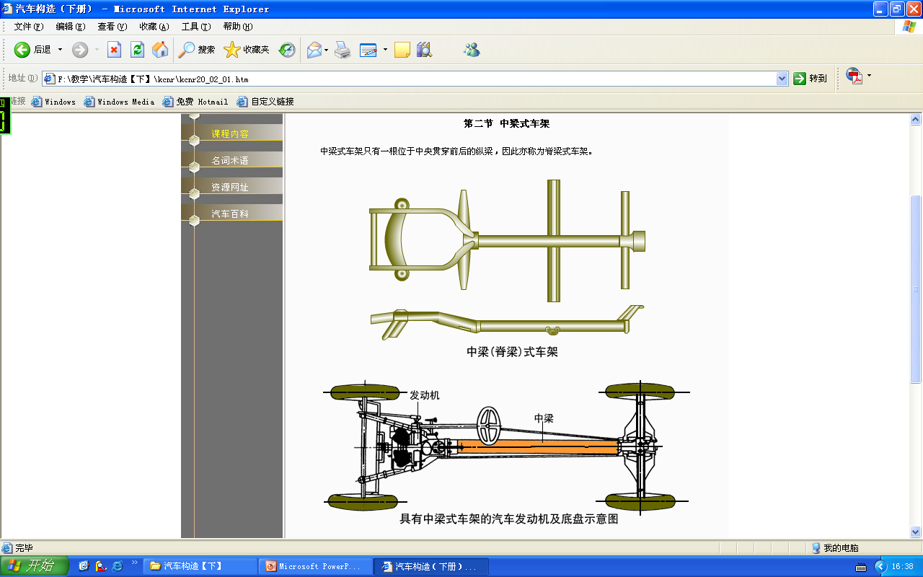
第二节 中梁式车架
Section 2: Backbone type frame
中梁式车架只有一根位于中央贯穿前后的纵梁，横梁焊接在纵梁的两侧，亦称脊梁式车架。Backbone type frame has only one longeron positioned in the middle through the body, the crossbeam is welded by both of its sides.

Slide 17
中梁（脊梁）式车架Backbone type frame
车架的扭转刚度大；The torsional stiffness of frame is large;
质量轻，减少了整车的重量；Light weight. Reduces the whole weight of the vehicle;
中梁可以封闭传动轴，起到防尘隔振的作用；The backbone can enclose the drive shaft and this helps vibration isolation and it’s dustproof;
可以降低底板高度和整车的重心高度；This type of frame can lower both the height of floor and the center of gravity of the vehicle;
零部件布置安装不便、工艺复杂，精度要求高、维护和修理不便。The arrangement and installation of components is hard to do. It has complicated technology, requires very high accuracy and is inconvenient to maintain and fix.

Slide 18
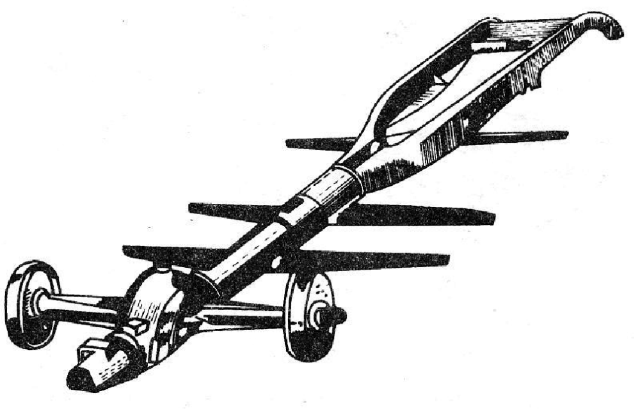
第三节 综合式车架
Section 3: Integrated type frame
车架前部是边梁式，而后部是中梁式，这种车架称为综合式车架（也称复合式车架）。它同时具有中梁式和边梁式车架的特点。The front part of frame is fringe-beam type and the rear part backbone type. This kind of frame is called Integrated type frame. It has features of both Fringe-beam type and backbone type frame.
边梁式Fringe-beam type
中梁式Backbone type
中梁+边梁的综合车架Fringe-beam type + backbone type=Integrated type

Slide 19
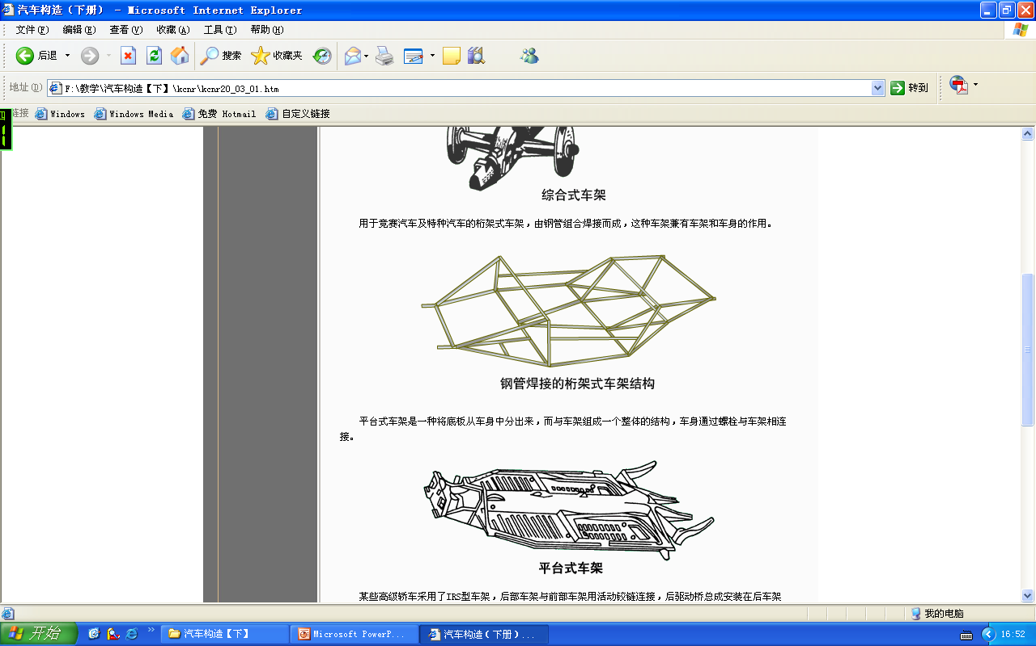
其它形式的车架
Other types of frame
一种将底板从车身中分出来，与车架组成一个整体的结构，车身通过螺栓与车架相连接。A structure that the floor is separated from the body and connected to the frame. The body is connect to the frame through bolts.
钢管组合焊接而成，车架兼有车架和车身的作用。The frame is welded by steel tubes and functions as frame and body.
刚度强度高、质量轻，适合于赛车。Large stiffness and strength, light weight, applicable to racing car.
有利于降低底板高度，共用底盘以及方便改型车。This frame can lower the height of floor and is easy to modify to recreational vehicle because of shared chassis.

Slide 20
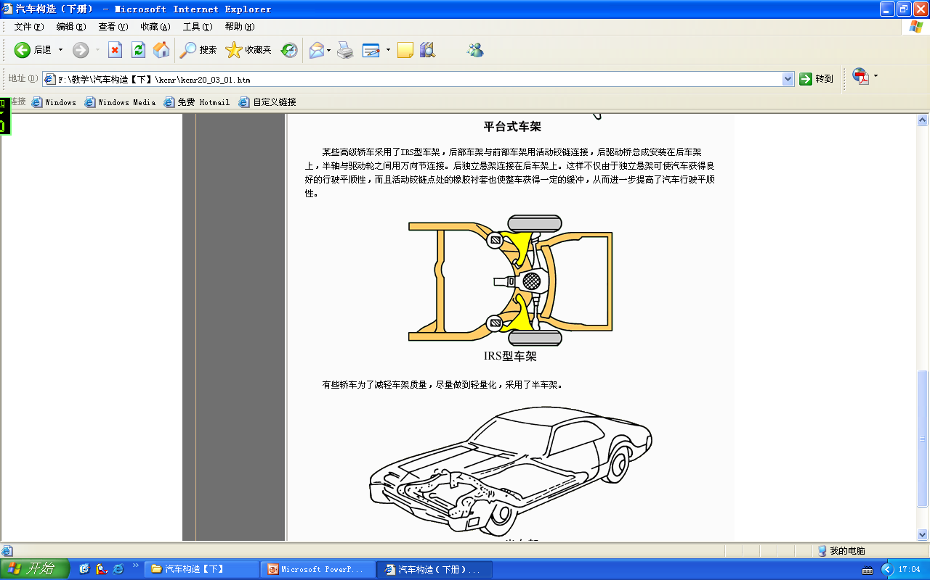
其它形式的车架
Other types of frame
车架分为前后两部分，并用铰链连接；The frame is divided into the front part and the rear part. They are connected through hinges;
可以方便的更改轴矩，生产不同轴矩的汽车。Wheelbase can be easily modified to manufacture vehicles of different wheelbases;
方便采用后独立悬架；Independent suspension can be easily adopted for the rear part;
提高车辆的行驶平顺性。 It can improve riding performance
汽车前部刚度较大；The front part of the vehicle has a larger stiffness;
车身局部得到加强；Some part of the body is strengthened;
有利于轻量化，减少整车重量。The frame is good for lightweight and reduces the whole weight.

Slide 21
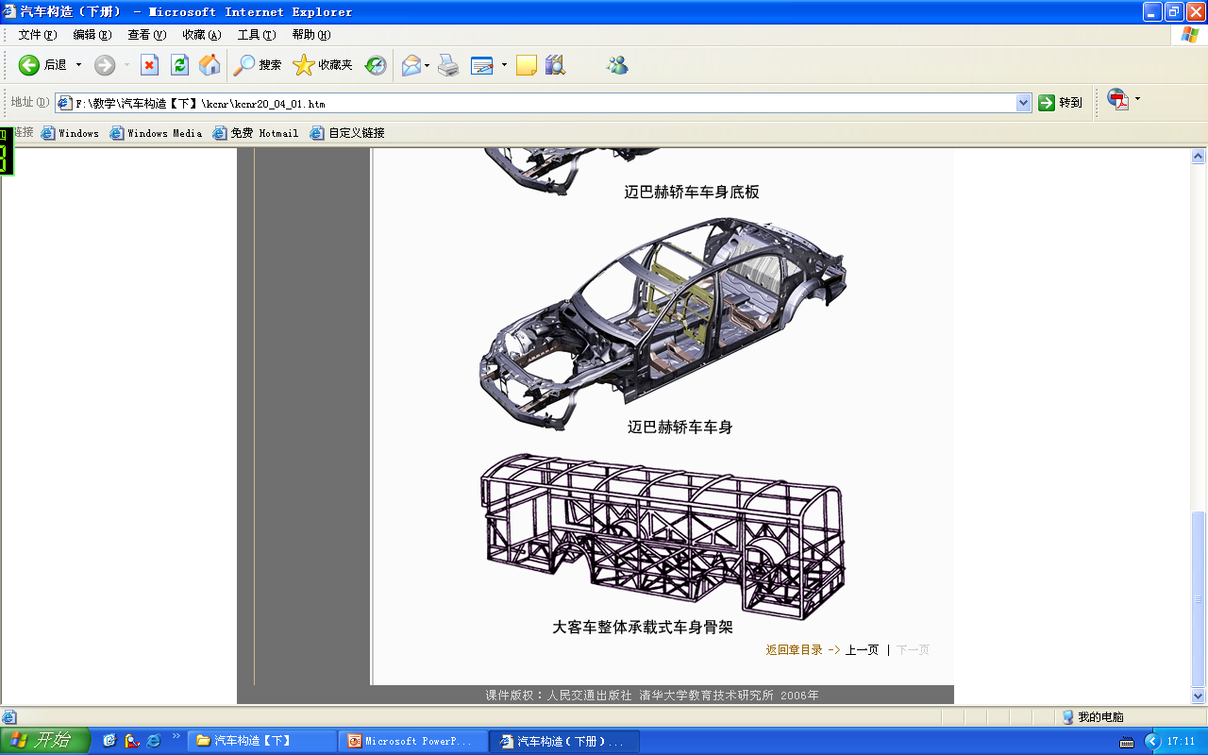
第四节 承载式车身
Section 4: Uni Body
大多数轿车和部分大型客车取消了车架，而以车身兼代车架的作用，即将所有部件固定在车身上，所有的力也由车身来承受，这种车身称为承载式车身。Most sedans and part of large coach do not use a frame and the body functions as frame. This means all the components is fixed on the body and all the forces is supported by the body. This kind of body is called Uni body.

Slide 22
承载式车身的优缺点
Advantages and disadvantages of Uni body
优点Advantages
质量轻； Light weight;
降低底板高度和重心高度；It can lower the height of floor and the center of gravity;
便于批量化生产；It’s easy to mass production;
车身参与承载，整体刚度好，碰撞安全性好。The body supports the weight. The stiffness is large, and it has good impact safety.
缺点
制造成本高；High cost;
不容易改型；Hard to modify;
需要采取隔振措施。needs to be isolated from vibration.

Slide 23
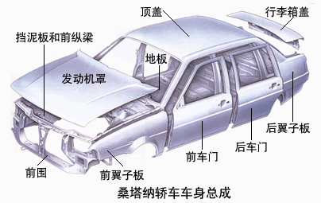
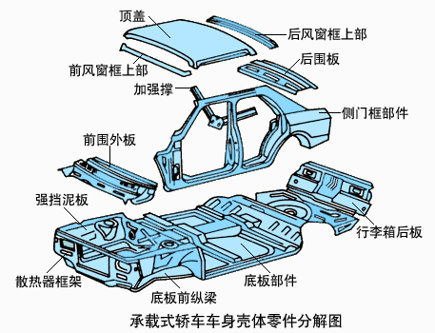
承载式车身的结构形式
Structure of Uni body

Slide 24
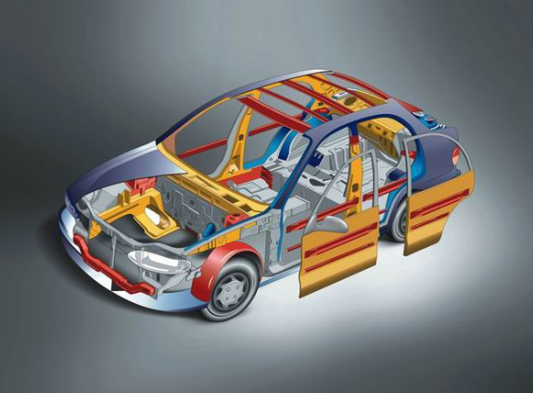
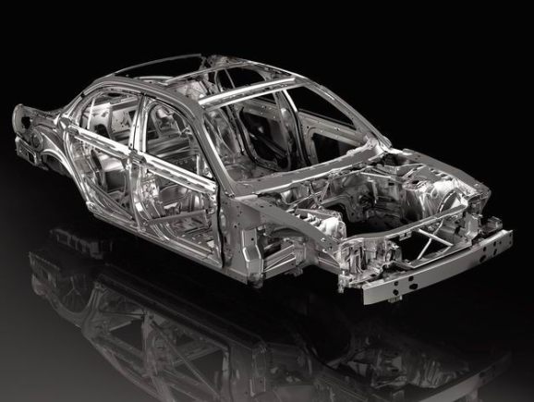
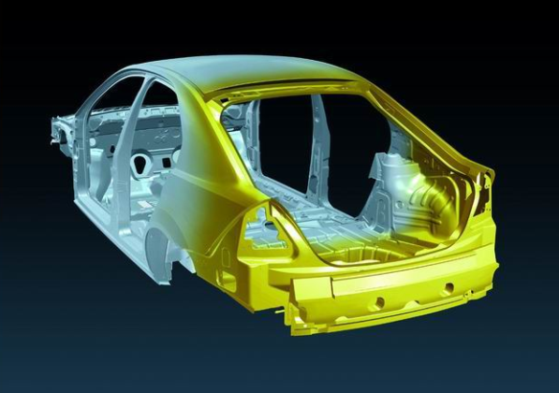
承载式车身的结构形式Structure of Uni body

Slide 25
本章学习重点
Key points of this chapter
车架的功用；The function of frame;
几种车架的结构特点；Structural features of these frames;
承载式车身的优缺点。Advantages and disadvantages of Uni body

Slide 26
作业
Homework
车架的功用式什么？What is the function of frame?
车架有几种结构形式，各有何特点？How many structural forms of frames are there? What are their features?
边梁式车架一般采取何种措施降低底板高度？What kind of method is often taken to lower the height of floor?
试述承载式车身的优缺点。Try to state the advantages and disadvantages of Uni body

